Slide 1
Signal Processing
Tirgul 4 - Cross correlation, Auto correlation and Convolution

Slide 2
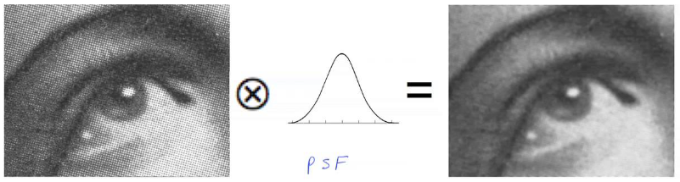
Cross Correlation and Convolution

Slide 3
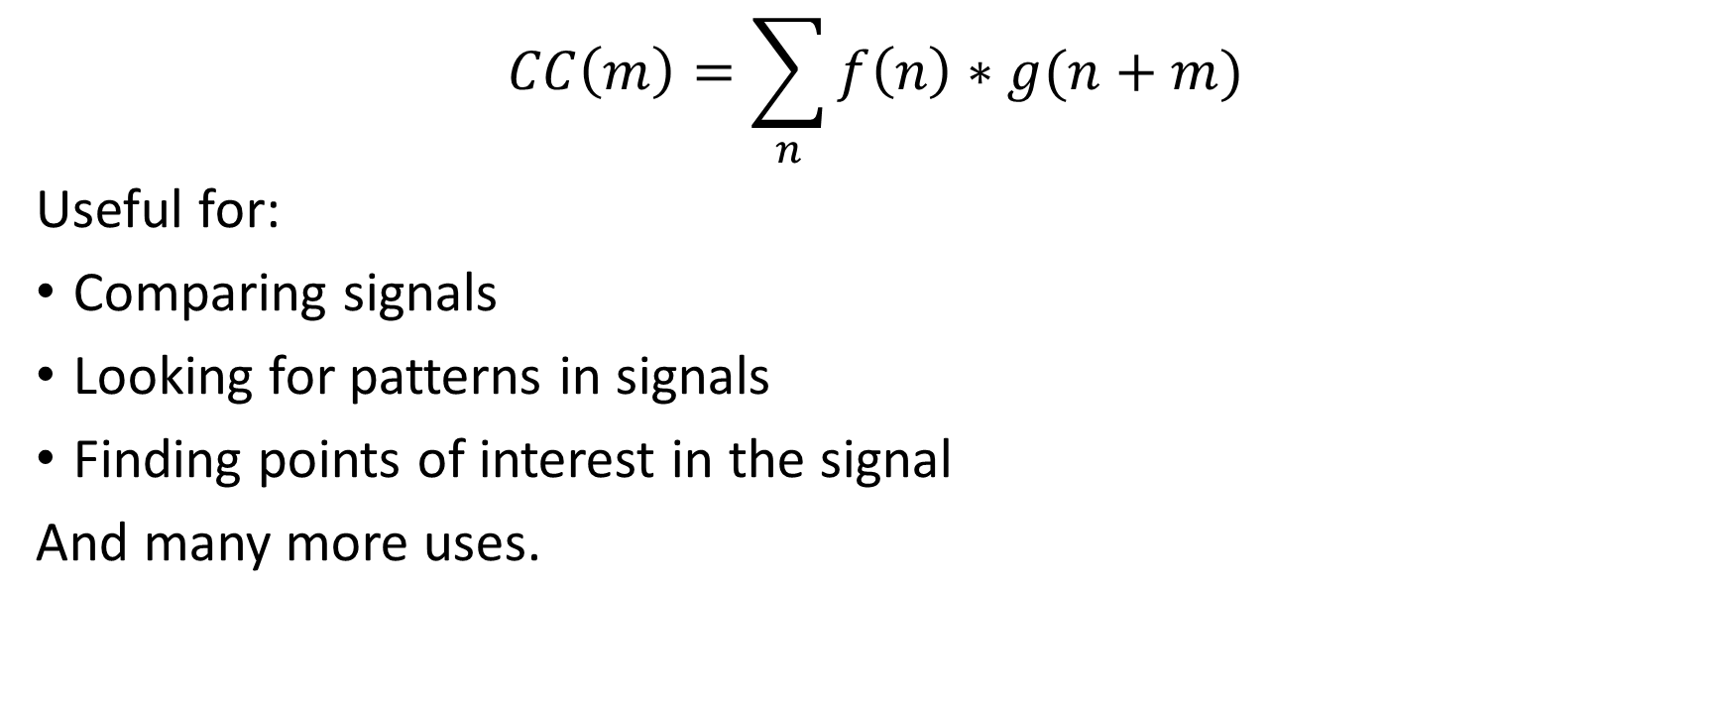
Cross Correlation
np.correlate(x, y, "full")

Slide 4
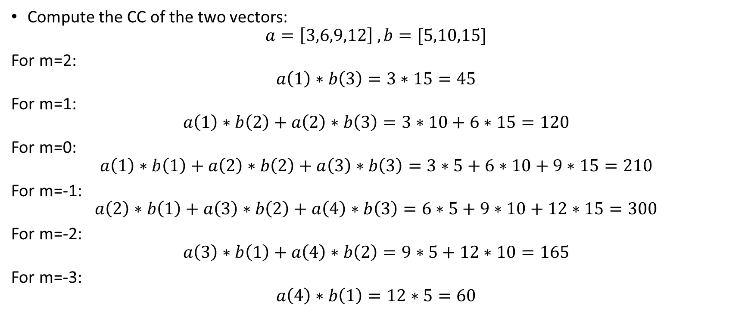
Example - Computing a CC

Slide 5
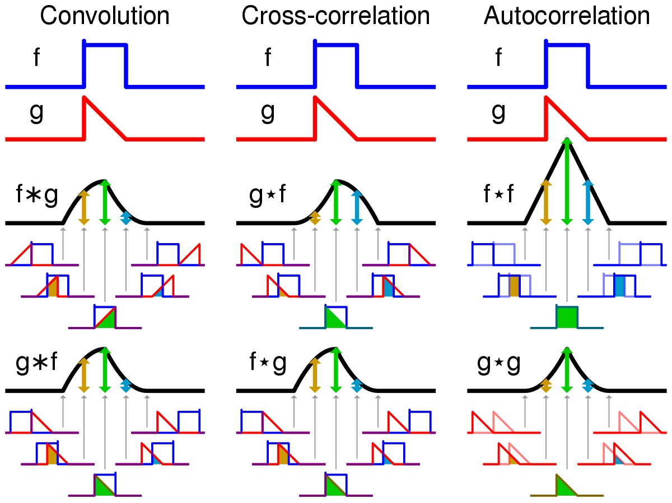
CC is not symmetric!
Signal A
Signal B
Signal B
Signal A

Slide 6
CC is a similar linear operation to Smoothing
We compute the cross-correlation between our signal (N points) and the window (which is another signal with K points).
The smoothed signal is the result of the cross-correlation.
The dimension of the CC result is N+K-1

Slide 7
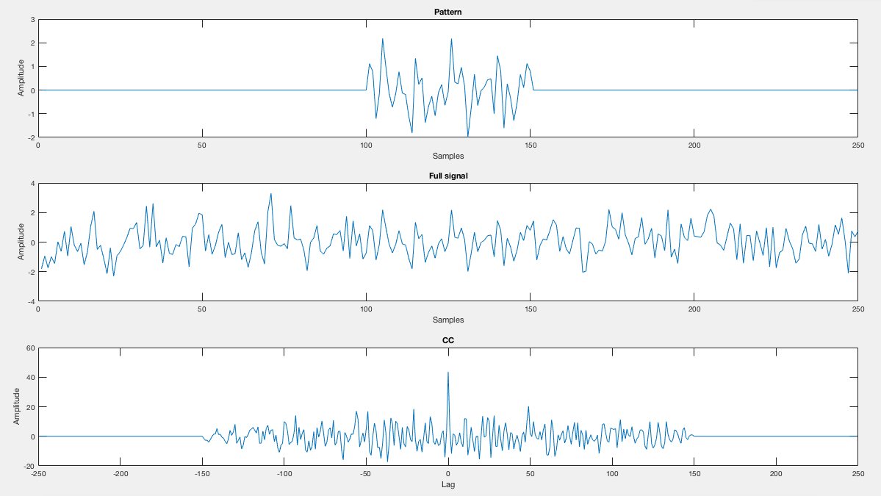
Finding shift between signals using CC
CC result
Length of 250+250-1
Time (ms)

Slide 8
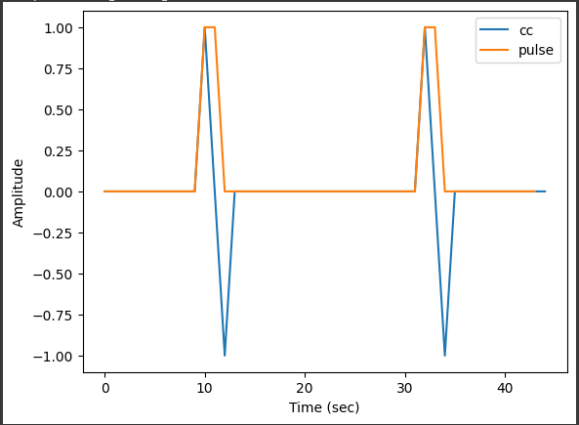
Using CC to find derivative - See example code in notebook

Slide 9

Convolution
A mathematical operation on two functions that produces a third function that expresses how the shape of one modified the other. same as CC , but one of the signals is reflected about the y - axis (doesn’t matter which one - commutative).
np.convolve(x, y, "full")

Slide 10
Convolution VS cross-correlation
Wikipedia

Slide 11
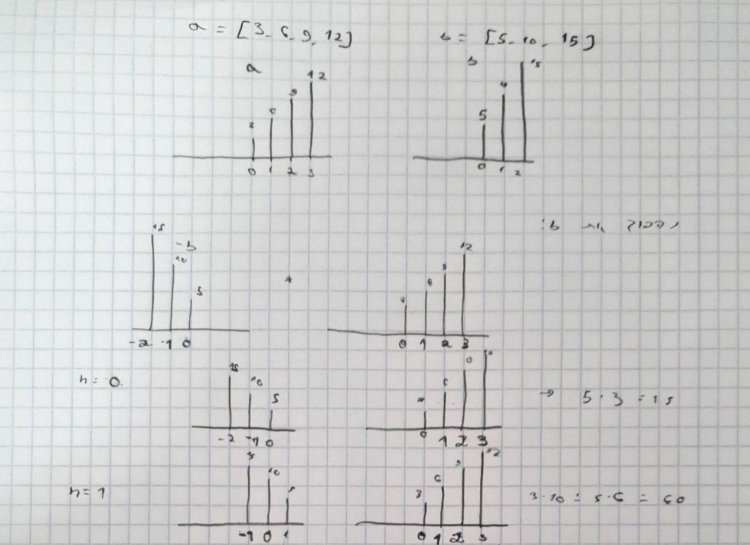
Convolution - example
same example as CC :

Slide 12
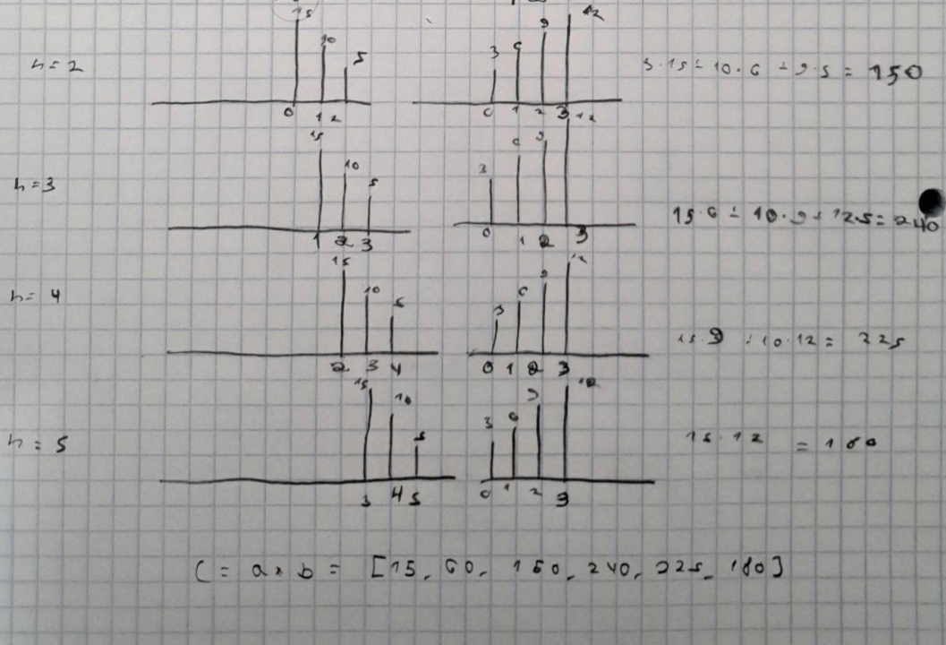
Convolution - example

Slide 13
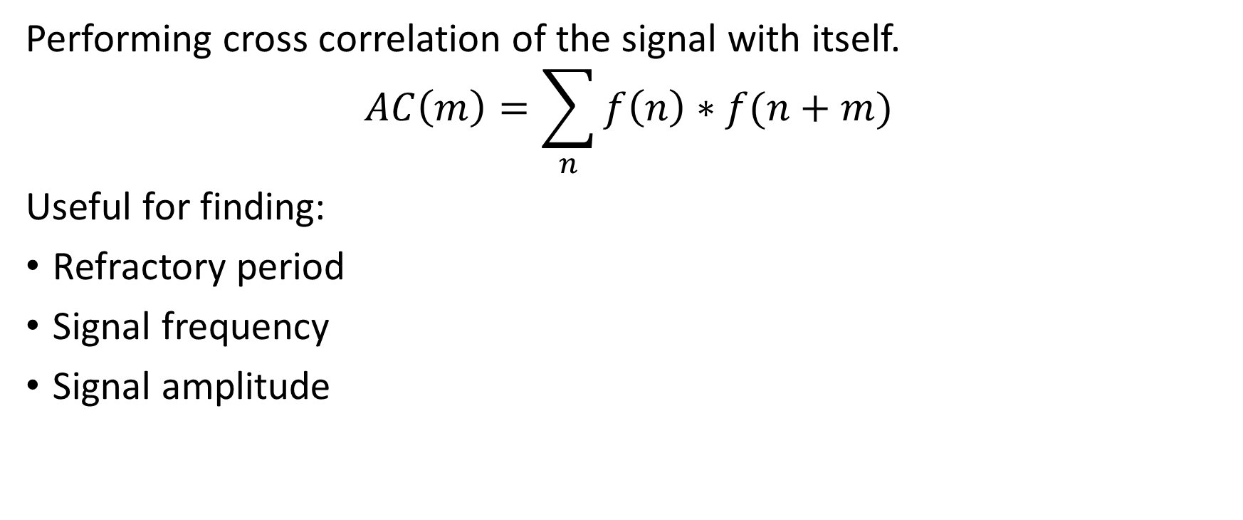
Auto correlation

Slide 14
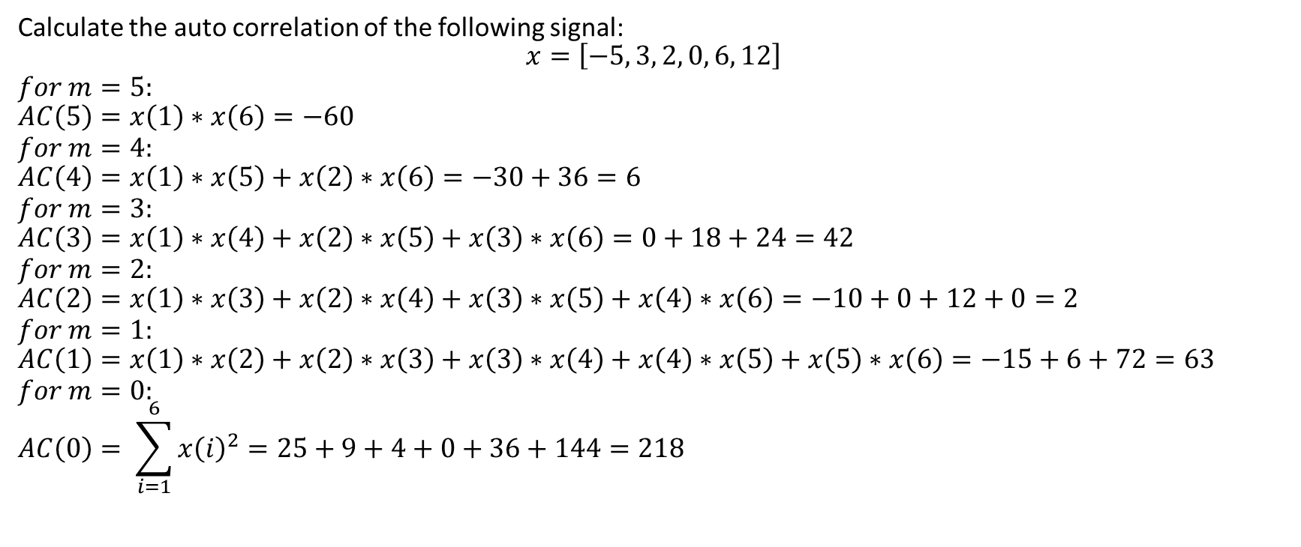
Auto correlation – Example 1

Slide 15
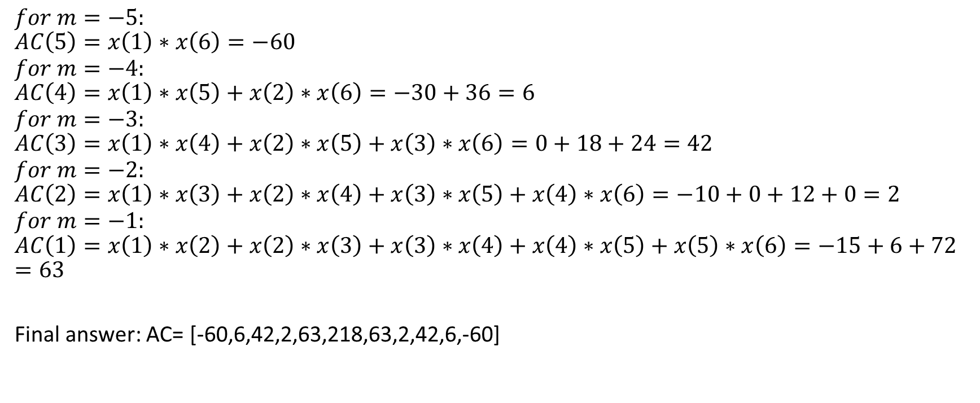
Auto correlation – Example 1

Slide 16
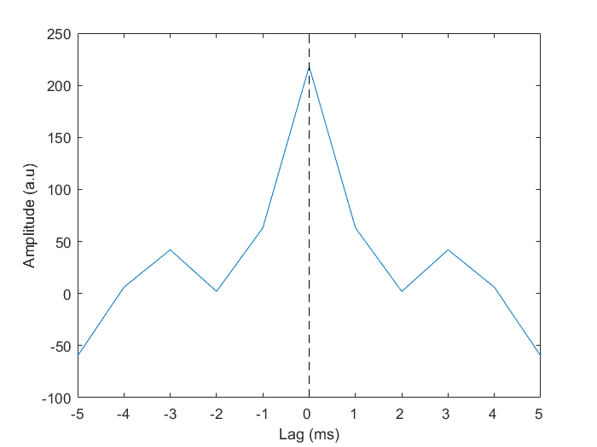
Auto correlation – Example 1
Final answer: AC= [-60,6,42,2,63,218,63,2,42,6,-60]

Slide 17
Auto correlation of spike trains
A spike train is a representation of the activity of a neuron using a vector of zeros and ones.
1 = Action potential (spike)
0 = no firing.
Usually each value represents 1ms bin.
Spike train example:
0 0 0 1 0 0 1 0 0 0 0 0 0 1 0
(15 ms spike train with 3 spikes).

Slide 18
Auto correlation of spike trains
We use auto-correlation analysis over spike trains to study the:
Refractory period of the neuron. This is the period after a spike where the neuron can not fire again for X ms. This value is changing between different neuron types.
The rhythmicity of the neuron`s firing. If a neuron fires every 20ms, it means that it is firing in 1/0.02Sec = 50Hz.

Slide 19
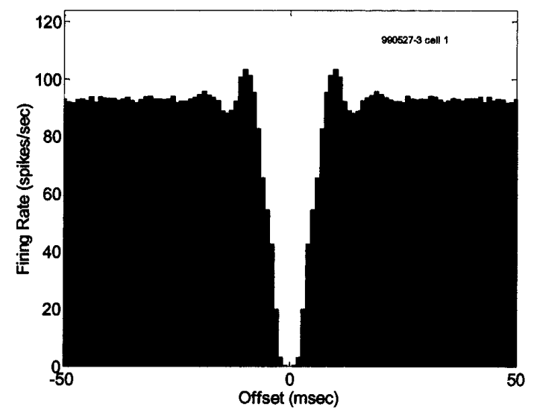
Autocorrelation – Poisson neuron. Why?

Slide 20
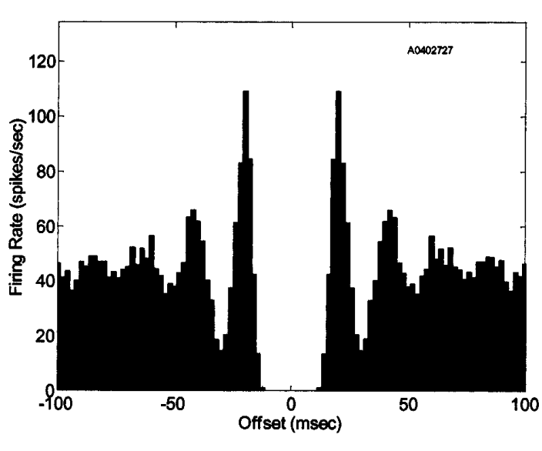
Autocorrelation – Oscillatory neuron. Why?
Bar-gad et al., 2000

Slide 21
Auto correlation – Example 3
Draw a schematic auto-correlation graph for a poisson process neuron, with an absolute refractory period of 10ms after each spike, and relative refractory period that halves the base fire rate for another 10ms.

